Slide 1
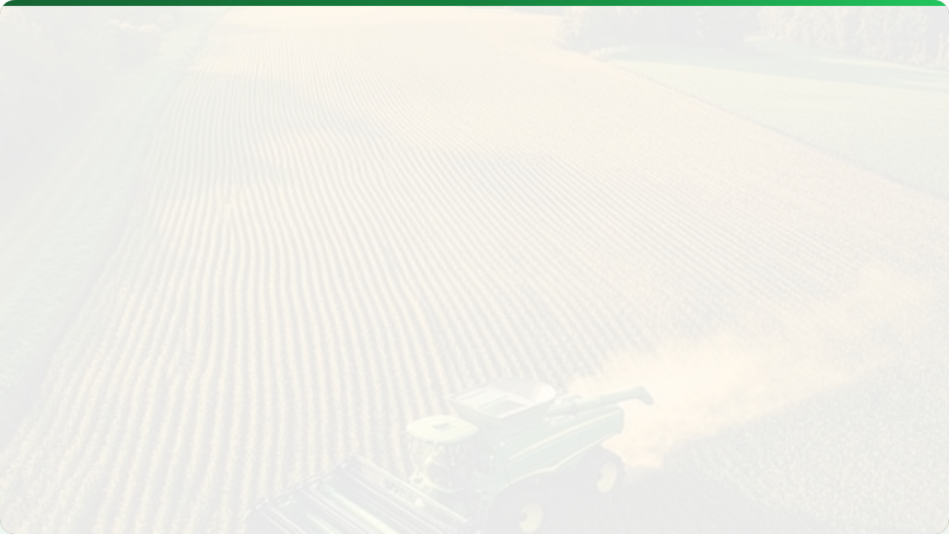



YIELD MONITORING & MAPPING
Lecture 9: The "Report Card" of the Farm
AGE 418
Dr. Kadeghe Fue

Slide 2
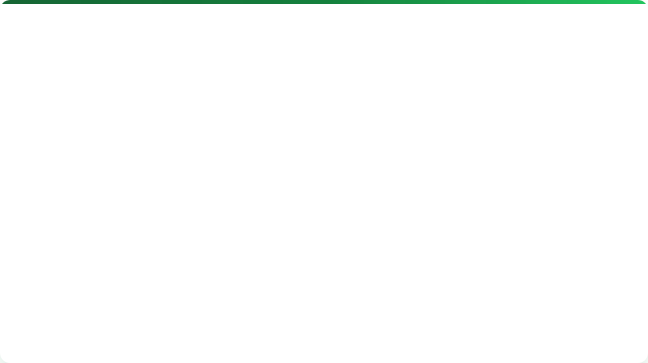



Lecture Roadmap
Part 1: The Hardware
Part 2: The Data
History & Importance
Calibration & Lag Time
System Components (Sensors)
Data Cleaning
The Impact Plate
Yield Mapping
Moisture Sensing
Interpretation

Slide 3
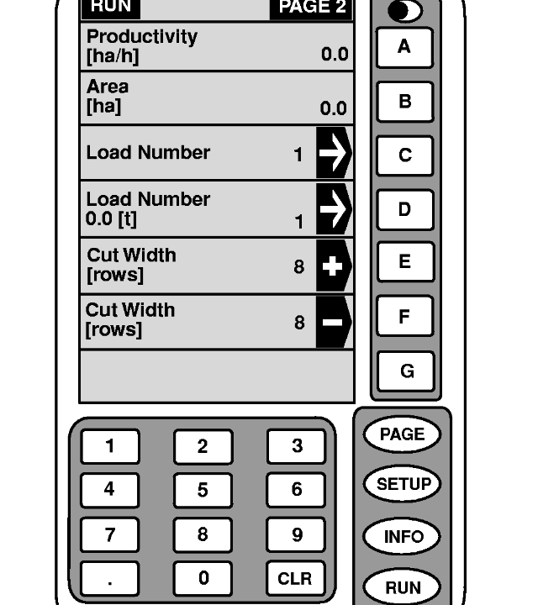

What is Yield Monitoring?
Definition: The real-time logging of crop output (mass/volume) and moisture as the harvester moves through the field.
It converts "Total Field Weight" into "Site-Specific Data".
"If you can't measure it, you can't manage it."

Slide 4
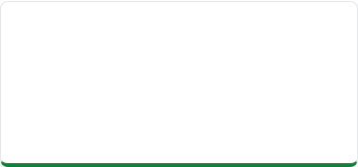
Evolution
Pre-1990s
1992
Today
Weighbridge tickets only. One yield number for the whole 50-hectare field.
Ag Leader 2000: First successful on-the-go yield monitor launched.
Factory standard. Cloud-connected. Maps appear on the phone instantly.

Slide 5


System Architecture
A Yield Monitor is a sensor network.
Mass Flow Sensor: Measures grain weight.
Moisture Sensor: Measures water content.
GNSS Receiver: Location (X,Y).
Header Sensor: "Is the machine harvesting?"
Display: The user interface.

Slide 6

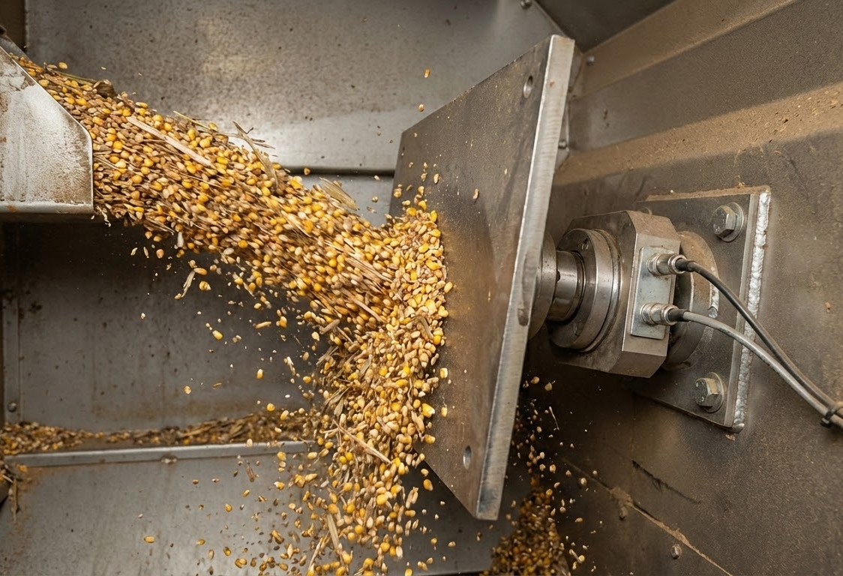

Component 1: Mass Flow Sensor
Impact Plate Principle
Grain is thrown from the clean grain elevator against a pressure plate.
Load cell measures force -> Converts to Mass.

Slide 7
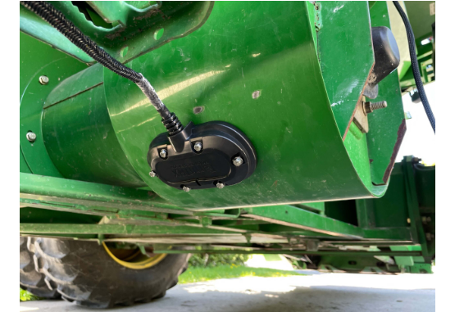
Component 2: Moisture Sensor
Why measure moisture?
Farmers sell "Dry Grain". Wet grain weight is misleading. We must subtract water weight.
Tech: Capacitance Plate (Dielectric constant).
Location: Side of clean grain elevator.

Slide 8

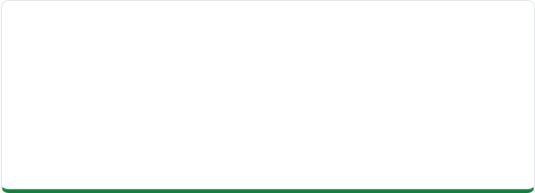


Component 3: Location & Speed
GNSS Receiver
Ground Speed
Logs position every 1 second (1Hz). Essential for Mapping.
Needed to calculate area covered per second. (Radar or GPS).

Slide 9

Component 4: Header Position
The On/Off Switch.
A simple potentiometer or switch.
Header Down: Recording Data.
Header Up: Stop Recording (Turning at headlands).
Prevents recording "Zero Yield" when turning.

Slide 10




Concept: Lag Time
The Delay Factor.
Grain takes ~10-15 seconds to travel from the cutter bar (front) to the impact sensor (top).
Without Lag Correction, the yield map would be shifted 20 meters forward!

Slide 11
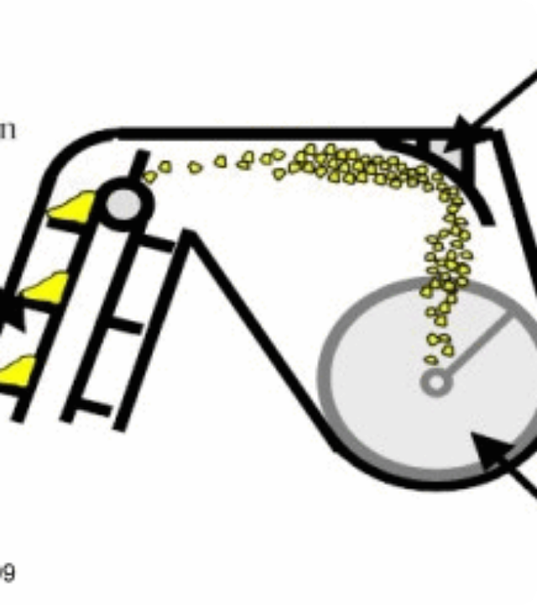
Calibration
Ground Truthing.
Sensors drift. You must teach the machine what "1 Ton" actually weighs.
Harvest a load.
Weigh it on a static scale (Weigh Wagon).
Enter actual weight into the monitor.

Slide 12
Sources of Error
Error | Cause | Result
Swath Width | Taking less than full header width. | Underestimated Yield
Lag Time | Incorrect delay setting. | Map Shifted
Sensor Buildup | Sap/Dirt on impact plate. | Inaccurate Readings

Slide 13

Data Cleaning
Raw data is messy. Before mapping, we must filter:
Start/End Pass: Combine ramping up/down speed.
Outliers: Points reading 0 or 25 tons/ha (Impossible).
Headlands: Turning areas with double harvesting.

Slide 14
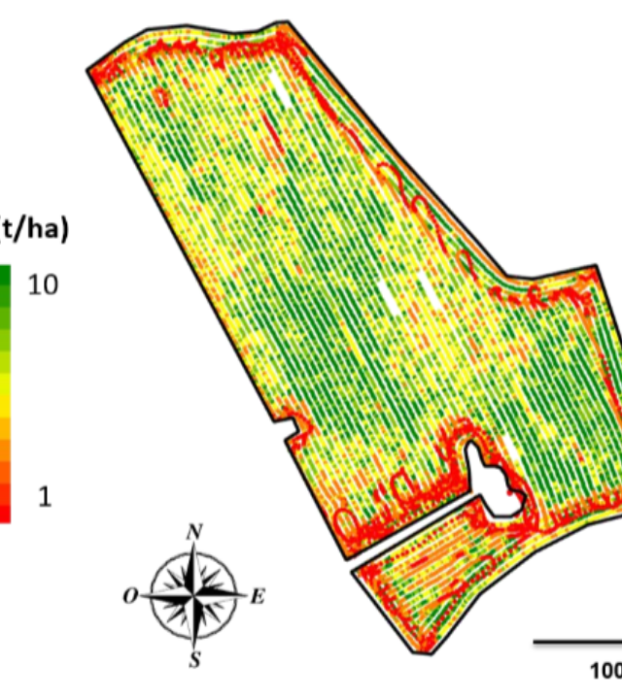
The Yield Map
The final output.
Green: High Yield.
Red: Low Yield.
This map is the "Report Card" for the entire season's management.

Slide 15
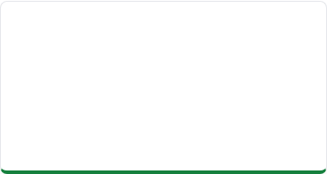
Interpreting the Map
Pattern: Strips
Pattern: Irregular
Pattern: Edge
Cause: Man-made.
Ex: One clogged planter row or sprayer nozzle.
Cause: Natural.
Ex: Soil type change, topography, pest infestation.
Cause: Environmental.
Ex: Tree shading, compaction from turning.

Slide 16


Correlation Analysis
We stack the Yield Map over other layers to find the "Why".
Yield vs. Topography: Drowning in low spots?
Yield vs. Soil EC: Sand vs Clay performance.
Yield vs. Variety: Did Hybrid A beat Hybrid B?

Slide 17
Normalization
Comparing different years/crops.
You cannot compare 2023 Maize (Ton/Ha) directly to 2024 Beans.
Solution: Convert to % of Field Average.
> 120% = Stable High Zone | < 80% = Stable Low Zone

Slide 18

Future: Quality Sensing
Moving beyond just "Weight".
New sensors use NIR spectroscopy on the clean grain elevator to measure:
Protein (Wheat)
Oil (Soybeans)
Starch (Corn)
Allows segregating premium grain in the field.

Slide 19
Lecture Summary
Hardware
Data
Value
Impact plate (Mass), Capacitance (Moisture), GNSS (Location).
Requires Calibration and Cleaning (Lag time correction).
Yield Maps are the foundation for Variable Rate prescriptions for the next season.
Next Class: Lecture 10 - Data Management

Slide 20

Questions?
Dr. Kadeghe Fue | AGE 418
Sokoine University of Agriculture

